Slide 1



Assessing the Genetic Contribution of Drug Response Variability in Selective Serotonin Reuptake Inhibitors From 1,711,695 Purchases in the Finnish National Drug Registry
2020 World Congress of Psychiatric Genetics
October 20th, 2020
Session: Pharmacogenomics
Kumar Veerapen, PhD
Postdoctoral Research Fellow
Daly lab
@mkveerapen
veerapen@broadinstitute.org
#ATGUstrong

Slide 2
Disclosure Slide
Ari Ahola-Olli: medical adviser at Abomics
Ben Neale: member of the Deep Genomics Scientific Advisory Board and serves as a consultant for the Camp4 Therapeutics Corporation, Takeda Pharmaceutical and Biogen.
Mark Daly: founder of Maze Therapeutics.
The remaining authors declare no competing interests.
Kumar Veerapen, PhD
I have nothing to disclose

Slide 3
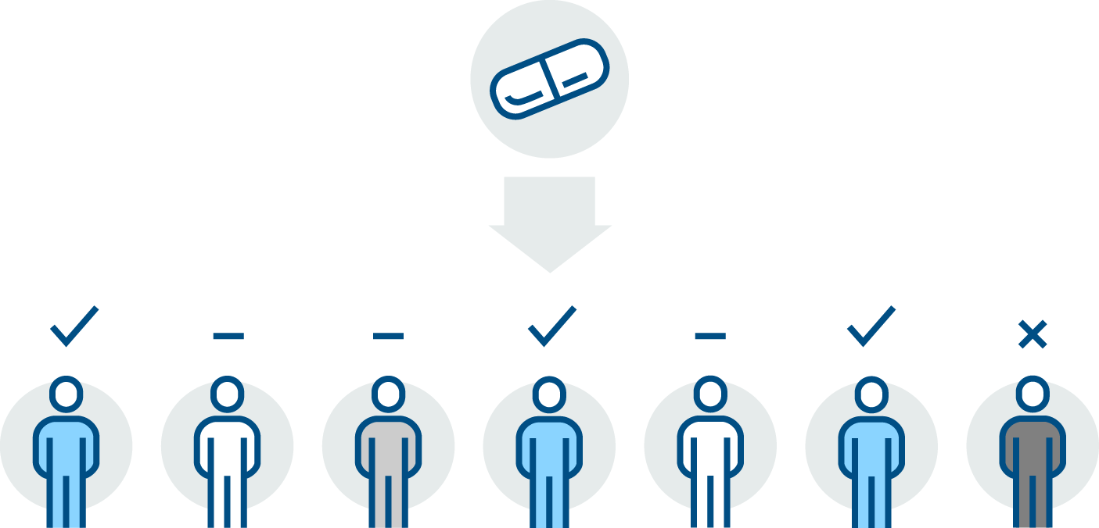


SSRI Drug Response Variability
Selective Serotonin
Reuptake Inhibitors
(SSRI)
In FinnGen, high correlation between depression and the use of SSRI
(r² = 0.518)
Prescribed to MDD patients
Response
No effect
Adverse Response
53-65% MDD patients respond to SSRI
(Hamilton Rating Scale for Depression)
(Hirschfeld et al 1999, J Clin Psychiatry)
Note: MDD – Major Depressive Disorder

Slide 4
Generating Results from FinnGen
Population samples
218,792 individuals
Combined genotype and register data
Imputation
Total markers: 16,962,023
Genotyping
(655,973 markers)
National register data
(Prescription Drug Purchase)
Years captured: 1995 - 2017
Longitudinal data points: 84,477,978
Drug Purchases: 42,776,151
Hospital biobank samples
Blood Service’s biobank
Association analyses
Current data freeze for release 5:
218,792 individuals

Slide 5
Objective
To understand the genetic basis of SSRI response variability by leveraging genotype-drug purchase data from 218,792 individuals in FinnGen Release 5.

Slide 6
Analysis Plan
Genotyped and Imputed:
Total markers: 16,962,023
Antidepressant Purchases
218,792 individuals with 1,711,695 purchases
Years = 1995 to 2017
Association Analysis (SAIGE v0.42.1) Phenotypes tested adjusting for sex, age, batch, and first 10 PCs:
SSRI vs no SSRI purchase
SSRI Number of Purchases
SSRI adherence
SSRI dosage change over time
Significance threshold: p < 5x10⁻⁸
Longitudinal SSRI Purchases
51,519 individuals
853,286 purchases
Notes:
don't spell out your covariates (just say "adjusted for a number of covariates" and leave them on the slide for people to read)
What is SAIGE?

Slide 7

Analysis 1: SSRI vs non-SSRI
Trait type:
Binary
Purchaser vs non-purchaser
VS
Minimum of ONE SSRI purchase
NO / ZERO record of SSRI purchase
N_{SSRI} = 41,147
N_{non-SSRI} = 159,788
Question:
Are there genetic differences observed with the purchase of SSRI?

Slide 8
MDD Polygenic Risk is different in SSRI vs no-SSRI
Non-SSRI
SSRI
MDD to Antidepressants:
r_{g} = 0.997
MDD to SSRI:
r_{g} = 0.732
β = 0.234
p = 0.0149
Non-SSRI
SSRI
Note:
r_{g} – genetic correlation
MDD – major depressive disorder
SSRI – selective serotonin reuptake inhibitor
Summary statistics for PRS from
Wray et al 2018 Nat Gen

Slide 9
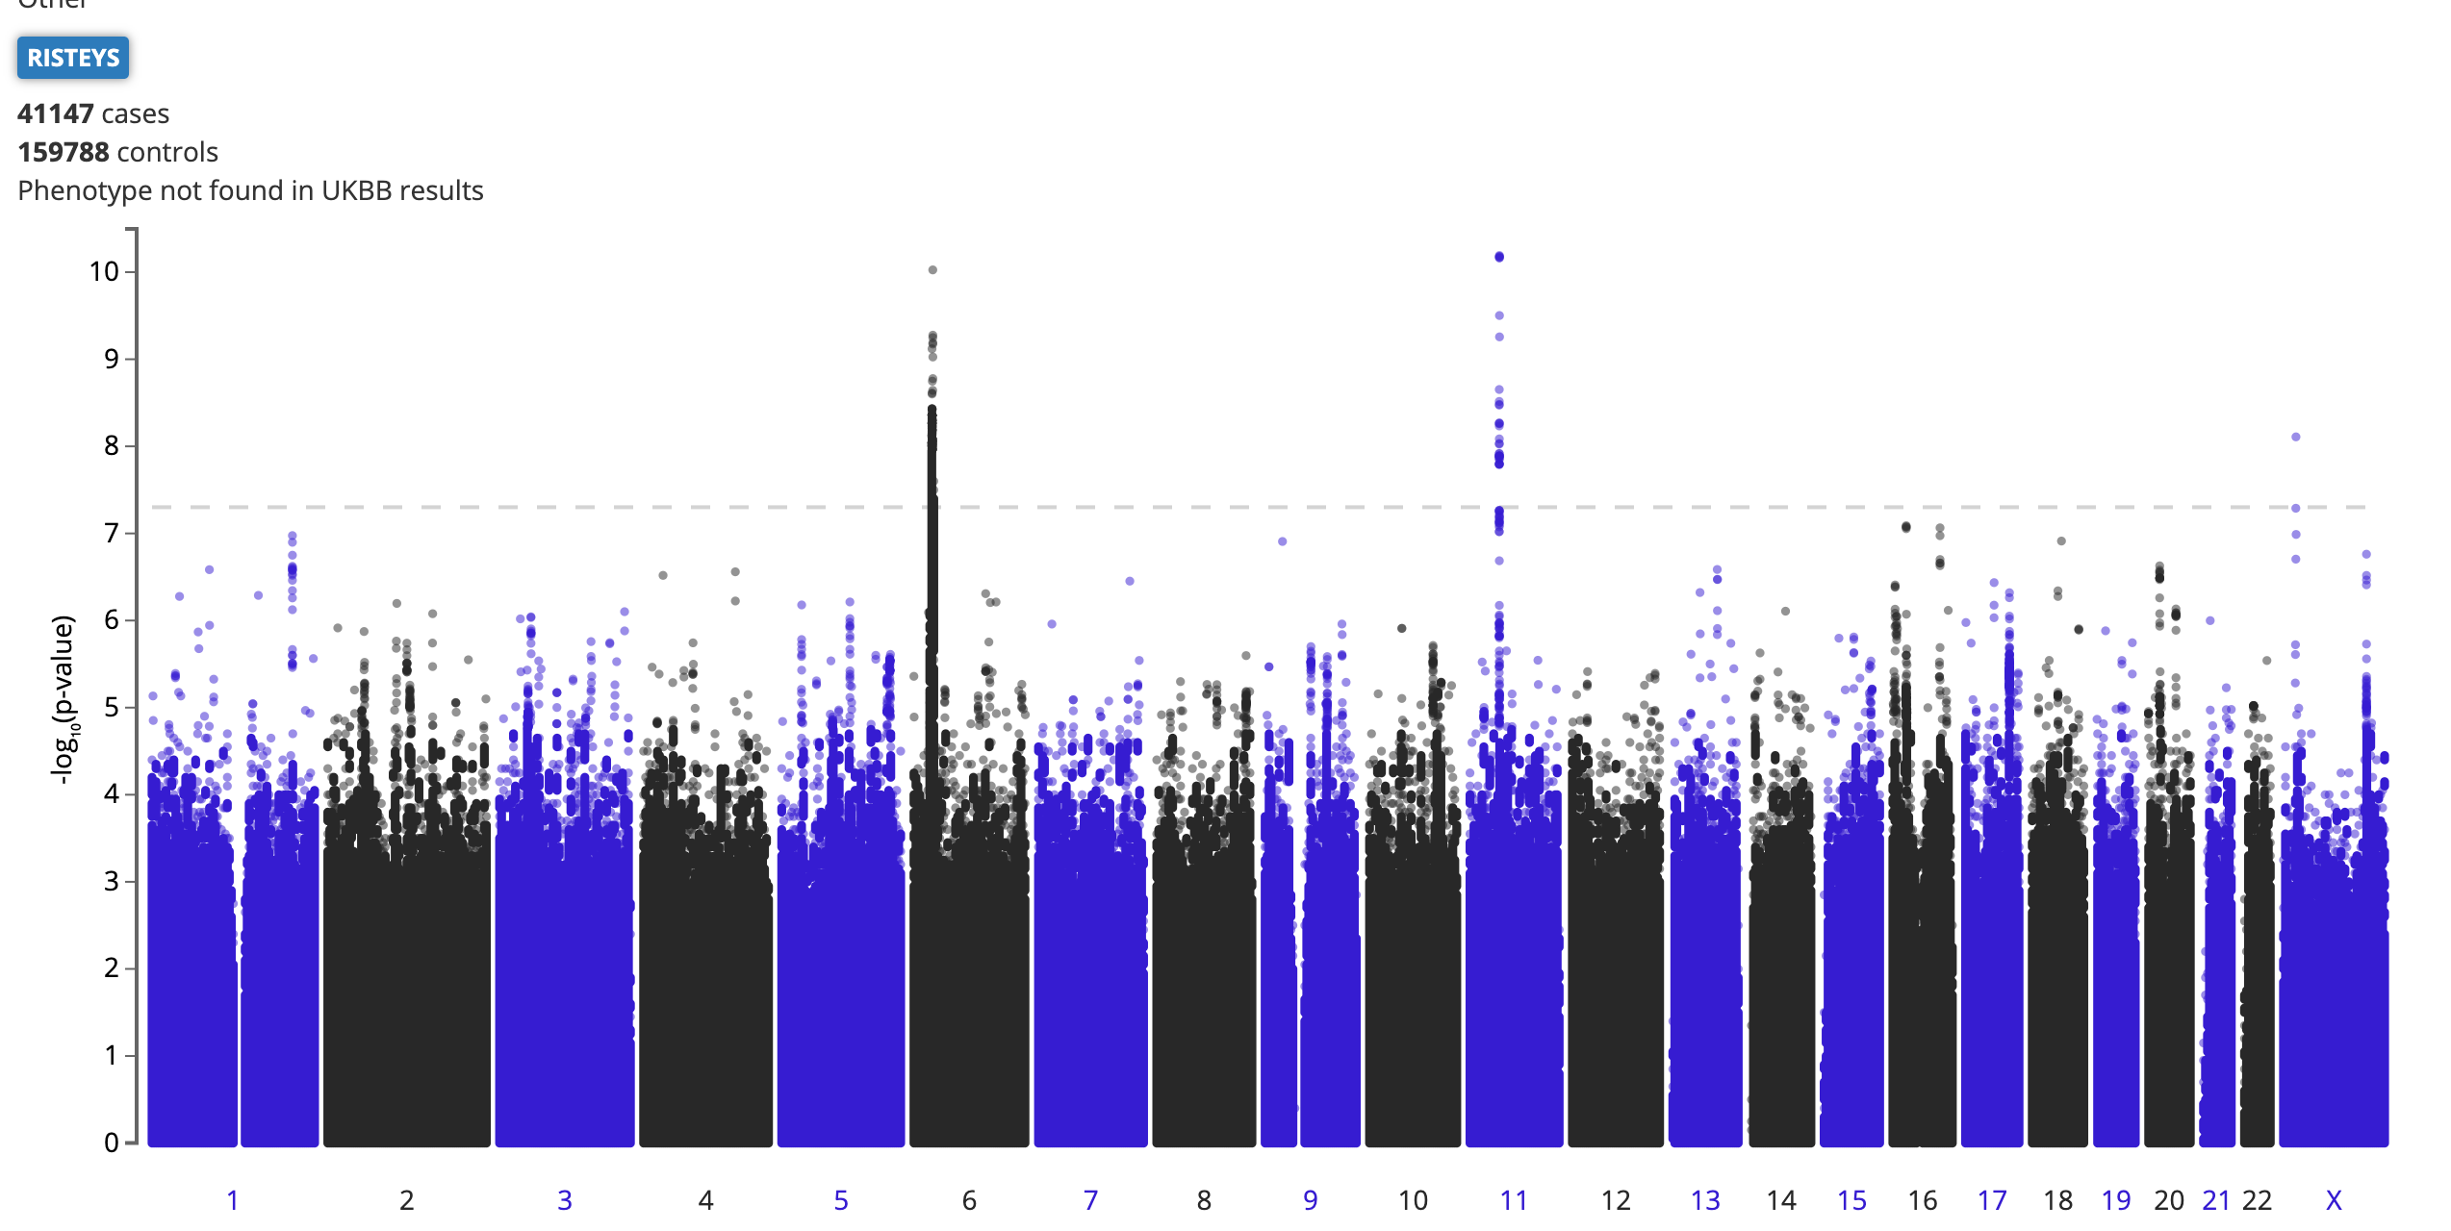
SSRI (N = 41,147) vs non-SSRI purchase (N = 159,788)
HLA-A
chr6:29978172:G:A
(intron)
AF_{FIN} = 0.0637
AF_{NFE} = 0.1131
β = -0.115
PHF21A
chr11:46035522:T:C (intron)
AF_{FIN} = 0.1988
AF_{NFE} = 0.1715
β = 0.0747
Endpoint: Binary
SSRI purchase/no purchase (0/1)
RPS6KA3
chrX:20353947:G:A
(intergenic)
AF_{FIN} = 0.03235
AF_{NFE} = 0.005866
β = 0.121
The enzyme PHF21A mediates repression of neuron-specific genes, potentially impairing serotonin metabolism in mice (Garay et al. 2016 Epigenomics).
Notes:
AF – gnomAD allele frequencies in Finns (FIN) and Non-Finnish Europeans (NFE)
Notes:
57883324 for 11 46035522
27867657 for 6
PHF21A mediates repression of neuron-specific genes, potentially impairing serotonin metabolism in mouse models (Garay et al 2016, Epigenomics)
Spend more time here
AF spectrum, the biggest MDD and how do they compare to this, possibly side by side, were these novel to MDD.
MDD pvalues from the phewas, table comparing betas, pvalues,
HLA is new and not captured in meta-analysis

Slide 10
Analysis 2: Number of SSRI Purchases
Trait type:
Quantitative
Number of purchases per individual
Range: 0 (no purchase record) – 288
Median: 7 purchases per individual
Question:
Are there genetic variants associated with the variability in purchase frequency of SSRI?

Slide 11
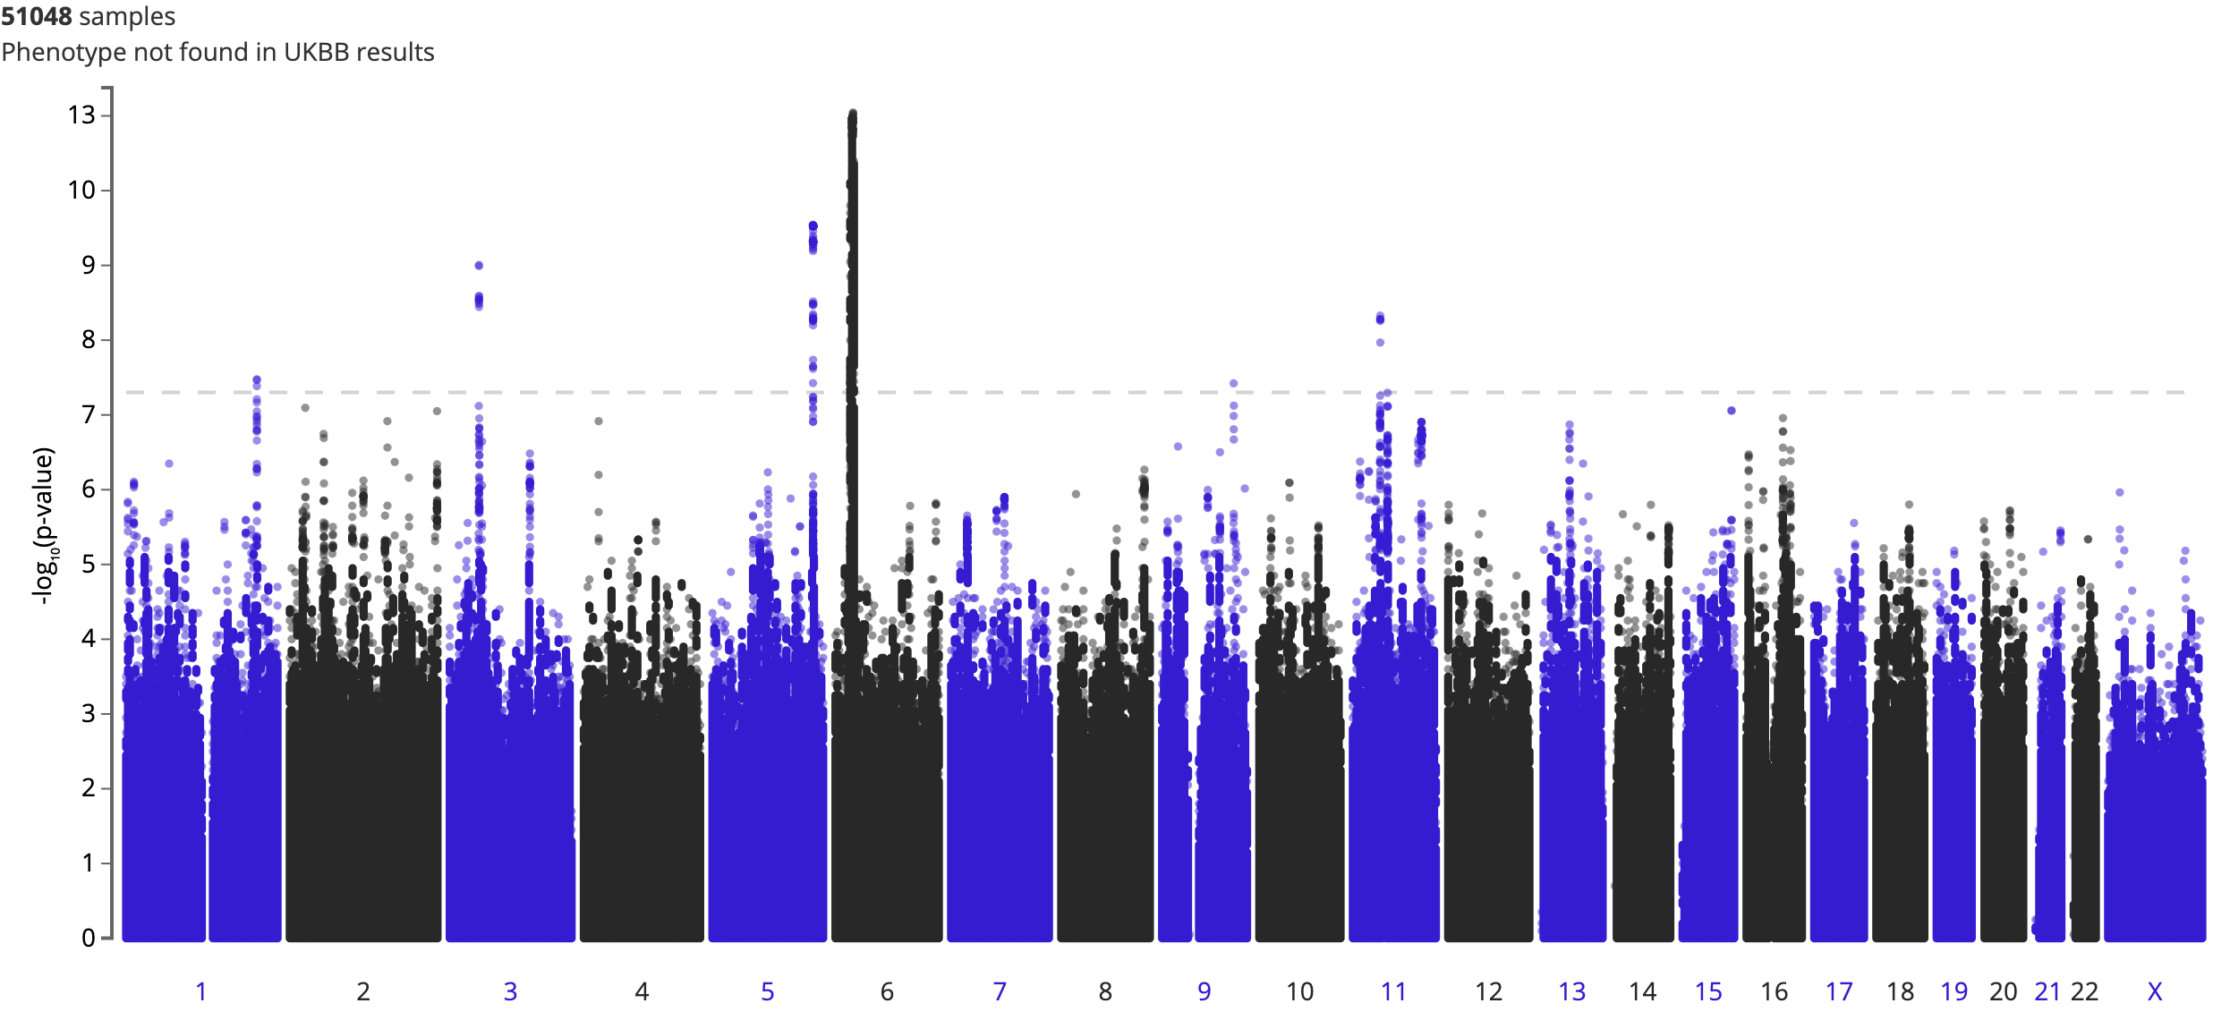
SSRI Purchases (Per Individual) (N = 200,935)
ARIH2
chr3:48972137:C:G
(intron)
AF_{FIN} = 0.1883
AF_{NFE} = 0.1257
β = -0.0185
RNF39
chr6:30070870:T:C
(3’ UTR)
AF_{FIN} = 0.05355
AF_{NFE} = 0.1024
β = -0. 0345
Endpoint: Quantitative
Range: 0 (no purchase record) – 288
Median: 7 purchases per individual
Inverse Rank Normalized
PHF21A
chr11:46035522:T:C
(intron)
AF_{FIN} = 0.1988
AF_{NFE} = 0.1715
β = 0.0165
PROX1
chr1:213928283:A:G
(Intron)
AF_{FIN} = 0.4105
AF_{NFE} = 0.5176
β = -0.0125
MAT2B
chr5:165056066:G:T
(intron)
AF_{FIN} = 0.5922
AF_{NFE} = 0.5223
β = 0.0143
TLR4
chr9:117728182:A:G
(intergenic)
AF_{FIN} = 0.01041
AF_{NFE} = 0.003856
β = -0.0605
S-Adenosyl methionine (SAMe) could be used as a supplement but still remains inconclusive (Cuomo et al 2020 Annals Gen Psych)
Systemic TLR4 is reduced with SSRI intake (Wang et al 2020 Neuroscience)
Note:
AF – gnomAD allele frequencies in Finns (FIN) and Non-Finnish Europeans (NFE)
Notes:
MAT2B found in Howard’s paper Methionine regulation
SAMe (S-adenosyl-L-methionine) used but not proven as a supplement to augment SSRI
SSRI and TLR4 – TLR4 is normalized in SSRI intake.
TLR4 close to metaanlaysis signal for MDD ~6KB
D’ = 1 and report more on R2, if you have a true signal R2 * chisq of true SNP, associations decay with R2
But these disappear when we remove the assumption that non-purchases are equal to 0
Across the board
But is there a genetic factor to purchases within the SSRI

Slide 12
Analysis 3: SSRI Adherence
Total antidepressant users: 86,404
Note:
NotSSRI includes (based on ATC code)
Non-selective monoamine reuptake inhibitors
Monoamine oxidase inhibitors
Monoamine Oxidase A inihibitors
Other antidepressants
Did not switch
from SSRI
N=22,778
VS
Trait type:
Binary
Switched from SSRI to any other antidepressant
N=17,789 (40,567 - 22,778)
Purchases SSRI only vs switched to another antidepressant
Question:
Are there genetic variants associated with switching from SSRI to
any other antidepressant?

Slide 13
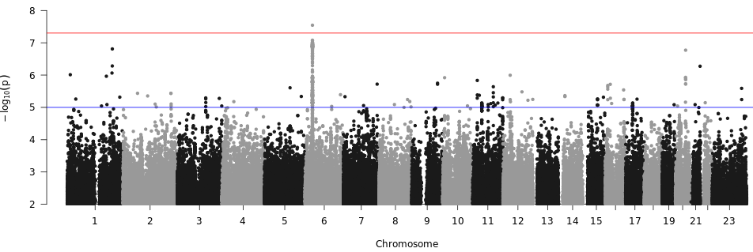
SSRI Adherence: From SSRI (N=22,778) to Any Other Antidepressant (N=17,789)
Not everyone sticks to SSRI as their effective antidepressant
HLA-DQB1
chr6:32658495:C:A
AF_{FIN} = 0.2567
AF_{NFE} = 0.2717
β = -0.106
Endpoint: Binary Switch Status (0/1)
MDD to Antidepressants
r_{g} = 0.997
MDD to SSRI Adherence
r_{g} = 0.431
Note:
AF – gnomAD allele frequencies in Finns (FIN) and Non-Finnish Europeans (NFE)
r_{g} – genetic correlation
Notes:
18,691 vs 13202
What is the endpoint and how did I define it?
Spend more time here
MAGMA results in Howards paper
SSRI contraindications to T1D
6 32658495 C A 9.690e-08 -0.1060 0.0199 2.872e-01 2.739e-01 2.960e-01 950.06 4835.53 1705.13 7653.18

Slide 14
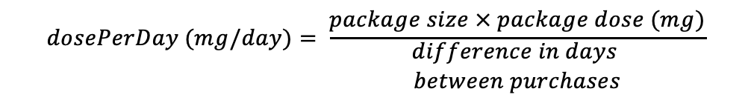
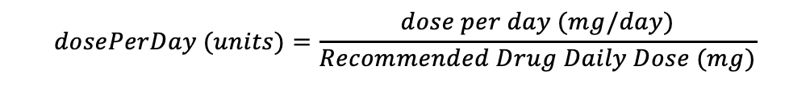
Analysis 4: SSRI Dosage Change over Time
$$dosePerDay (mg/day)= \frac{package size × package dose (mg)}{\begin{aligned}difference in days \\ between purchases\end{aligned}}$$
330,138
235,856
134,748
66,154
114,733
16,216
Generic Name (DDD mg)
Citalopram (20)
Escitalopram (10)
Fluoxetine (20)
Fluvoxamine (100)
Paroxetine (20)
Sertraline (50)
Removal of outliers (<10% and >90%)
Per unit transformation of each drug
$$dosePerDay (units)=\frac{dose per day (mg/day)}{Recommended Drug Daily Dose (mg)}$$
Sum across SSRIs and defined increase/decrease dosage over time
$$Dosage change{=dosePerDay}_{t=n} − {dosePerDay}_{t=0}$$
Increase : positive ”Dosage change”
Decrease: negative “Dosage change”

Slide 15
SSRI Dosage: Dosage Increase in per unit SSRI over time
Tracking dosage per unit of SSRI increase in months
(median= 40.10)
Trait type:
Survival
No dosage change vs increase in dosage over time
Question:
Are there genetic variants associated with SSRI dosage increase over time?
N=4,021
N=30,152
PTDSS2
chr11:476394:G:A
(intron)
p < 8.43 x 10⁻⁸
AF_{FIN} = 0.01185
AF_{NFE} = 0.02110
β = 0.224
The protein PTDSS2 has a high affinity for docosahexaenoic acid (DHA) : SSRI can be augmented with DHA (Li, Fan, and Wang. 2015. Glycomics and Lipidomics)
Note:
AF – gnomAD allele frequencies in Finns (FIN) and Non-Finnish Europeans (NFE)
Notes:
Mention that this is the one variant with the lowest p-value
Too many things -- see if there is a way to make this simpler.
Probably get rid of the
Explain the analysis and then just give the summ stats and mention that there was no GWAS significant hits
Maybe explain about the function, if there is time.

Slide 16
There is a larger proportion of SSRI purchasers compared to MDD
Were we just testing MDD patients for SSRI variability repeatedly?
Phenotype | Phenotype Correlation (r²) | Genetic Correlation (r_{g})
Antidepressants and MDD | 0.444 | 0.997
SSRI and MDD | 0.518 | 0.731
SSRI switch and MDD | 0.00347 | 0.0443
SSRI increase and MDD | 0.00703 | 0.0270

Slide 17
Conclusion and Future Studies
To the best of our knowledge, results shown are novel to depression etiology.
With simple phenotyping, we have shown that there is a genetic basis in SSRI response variability and warrants detailed interrogation.
Future studies:
major depressive disorder polygenic risk contributing to SSRI use and dosage changes
dosage patterns, and
adverse outcomes.
Notes:
these early analyses with simple phenotyping we showed that there is genetic basis in variability and will be studying that in more detail

Slide 18
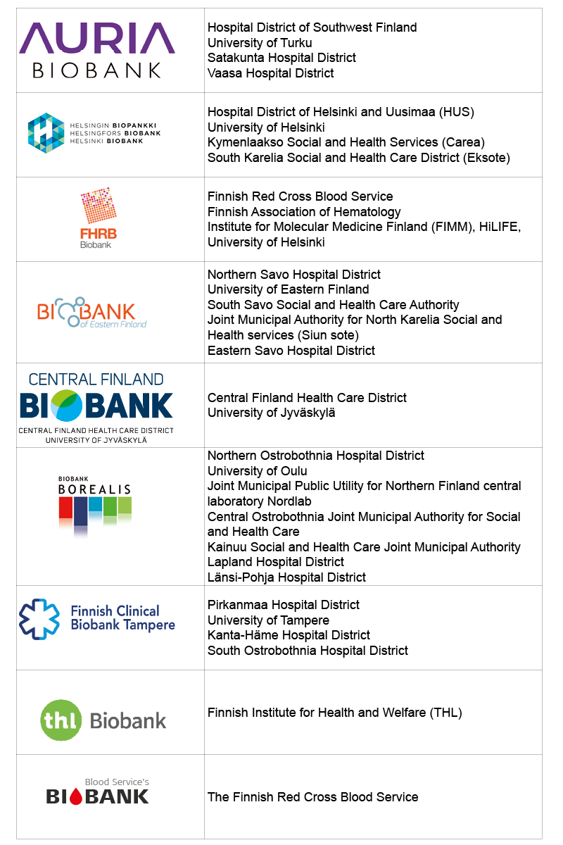



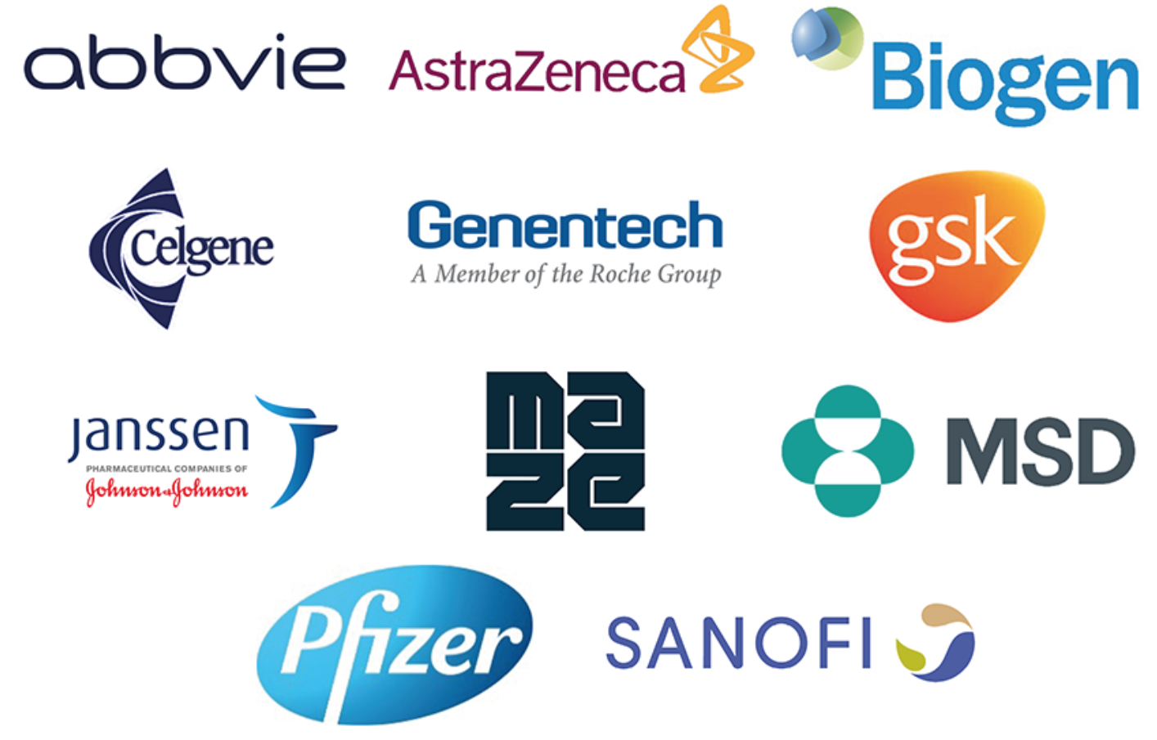
FinnGen Partners
Coordinating partners:
Biobanks:
Funding:
Funding partners:

Slide 19

Suuri kiitos! Onko kysyttävää?
Paljon kippiksia
Mark Daly, PhD
Mitja Kurki, PhD
Ben Neale, PhD
Tuomo Kiiskinen, MD
Juha Karjalainen, PhD
Ari Ahola-Olli, MD, PhD
Pietro Della Briotta Parolo, PhD
Jaana Suvisaari, MD, PhD
Wei Zhou, PhD
Hanna Ollila, PhD
Aarno Palotie, MD, PhD
2020 World Congress of Psychiatric Genetics
October 20th, 2020
Session: Pharmacogenomics
Kumar Veerapen, PhD
Postdoctoral Research Fellow
Daly lab
@mkveerapen
veerapen@broadinstitute.org
#ATGUstrong

Slide 20
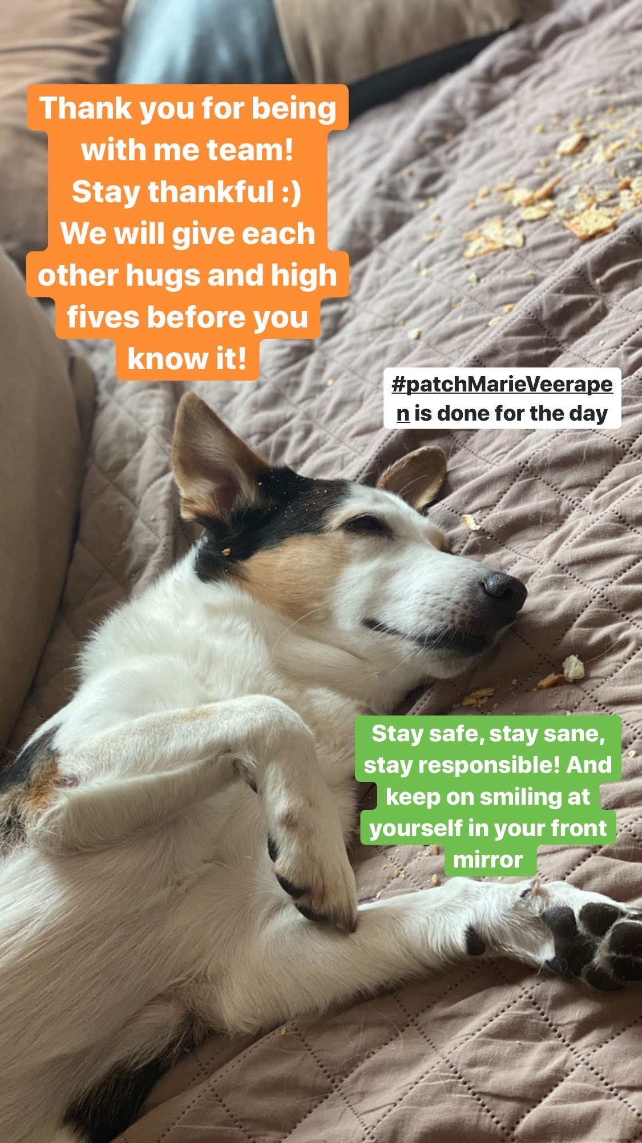

Slide 21
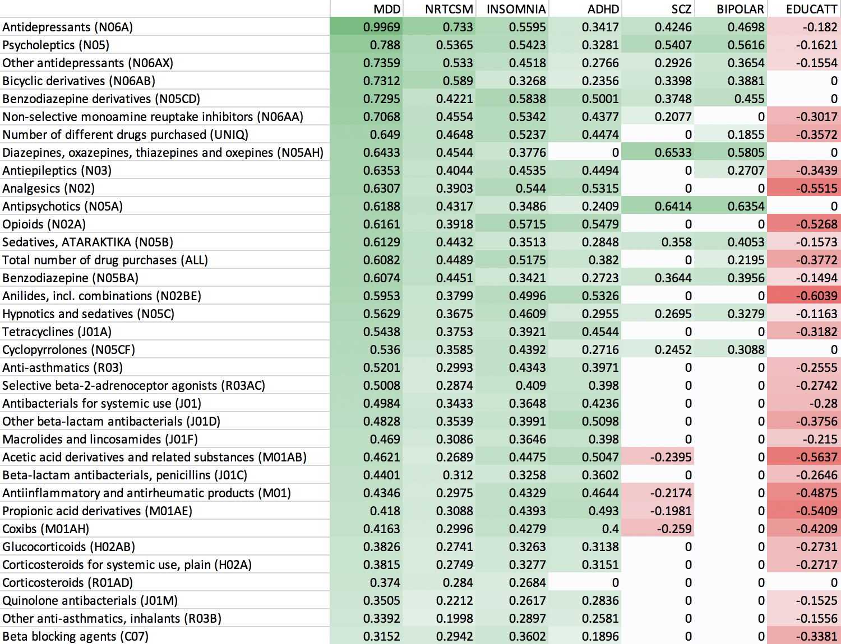
Genetics of use of various drugs correlate with psych traits
LDSC rg
Bonferroni non-significant
correlations are 0

